Slide 1
AI-Driven System for Classifying Skin Diseases from Images
Quarter / 10 17 2025
Presented by
Damian Williams
Sri Yalamanchili
Maddie Sidwell
Savannah Ostermeyer
Manuel Nieves

Slide 2
Problem Statement
Current Situation:
  Melanoma, one of the deadliest skin cancers, has increasing incident rates throughout the past several decades
Problem:
  Melanoma needs to be detected early to increase survival rates
Proposal:
  AI Driven Skin Classifying Diseases from Images
Predicted Outcome:
  Patients will receive accurate diagnosis from uploaded images resulting in earlier diagnosis of melanoma

Slide 3
Functional Requirements
Collect demographics, symptom descriptions, and allow users to upload lesion images.
Store medical rules, disease information, and apply reasoning or machine learning to support differential diagnosis with confidence scores.
Present possible diagnoses, next steps, and red-flag alerts, while generating patient reports and storing diagnostic history.
Integrate new knowledge and retrain models on updated datasets.

Slide 4
Nonfunctional Requirements
Intuitive interface for patients and dermatologists, accessible via web or mobile
Achieve ≥85–90% classification accuracy and generate diagnoses within seconds, handling multiple inputs efficiently
Ensure HIPAA/GDPR-compliant secure data handling and provide explanations highlighting key features of the diagnosis

Slide 5
Optional Requirements
Multilingual support: Add multiple language options for wider accessibility.
User account system: Allow patients and dermatologists to create accounts for uploading and saving cases.
Longitudinal tracking: This provides graphs that show how a lesion evolves over multiple uploads.
Telehealth API Integration: Connect with telehealth services for direct dermatologist consultation.

Slide 6
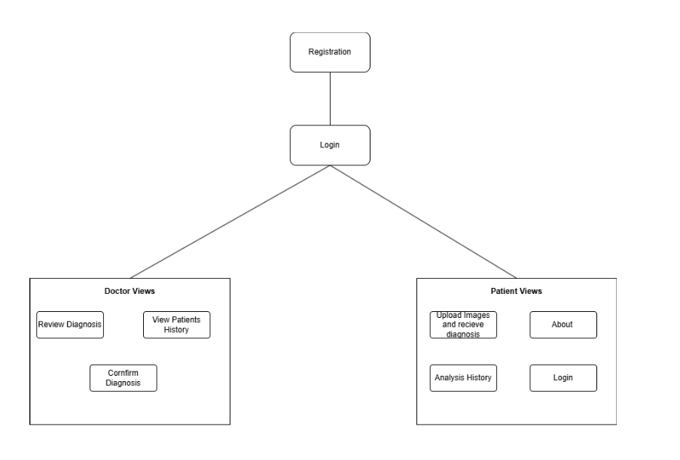
Website Architecture

Slide 7
Task Accomplished
Figma Prototypes
Frontend
  Login page
  Upload Page
  Reports
  Team
Importing and Preprocessing the HAM10000 Dataset
Beginning phases of lesion classification
  Separates images by nearest neighbor similarity
Setting up the virtual environment

Slide 8
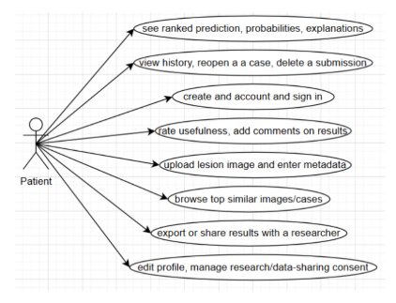
Patient User Stories
As a patient user, I want to
  Create an account and sign in so I can submit my lesion for analysis and view past results.
  Upload a lesion photo and enter basic info (age, sex, lesion site) so the system can analyze it accurately.
  Receive a ranked list of possible conditions with short explanations so I can understand the preliminary assessment.
  See similar past cases and visuals (e.g., heatmaps) so I can better interpret the results.
  See clear status/error messages, so I know if I need to re-upload or correct my inputs.
  Have the option to share my results with a doctor so I can get further guidance

Slide 9
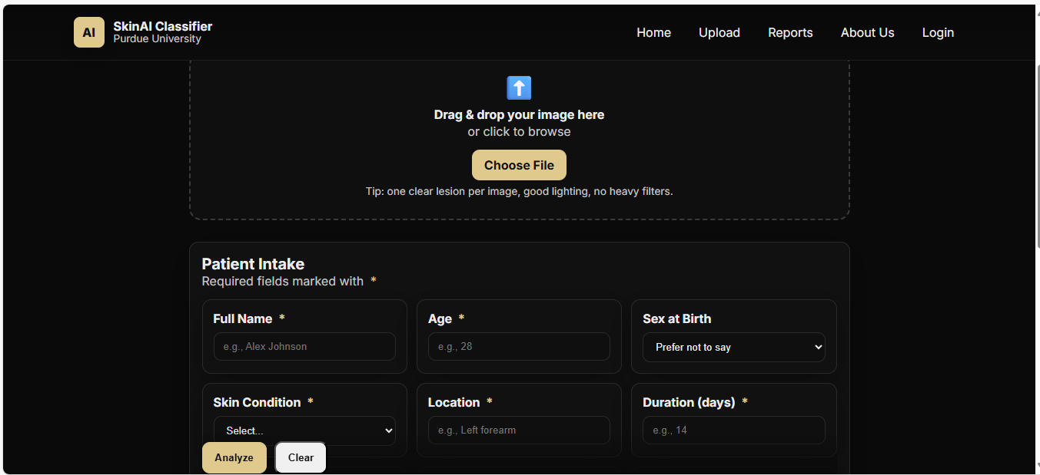
Upload Page

Slide 10
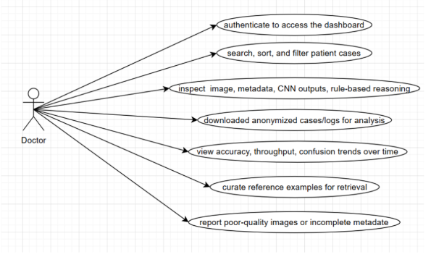
Doctor User Stories
As a doctor user, I want to
  Sign in to a doctor dashboard so I can review model outputs and rule-based explanations.
  Filter, search, and sort submissions so I can quickly find cases of interest.
  ·View combined CNN predictions and expert reasoning text so I can validate and refine diagnostic accuracy.
  Access to logs and aggregated metrics (e.g., accuracy over time) so I can evaluate system performance.
  Export anonymized data so I can conduct further research and reporting.
  Annotate or provide feedback on cases so I can help improve the model and rules.

Slide 11
Technology
· Programming Language: Python
· Deep Learning Framework: PyTorch (using a ResNet50-based convolutional neural network)
· Dataset: HAM10000 (Human Against Machine with 10,000 training images of skin lesions)
· Development Environment: Visual Studio Code (VS Code)
· Front-End Web Technologies: HTML and CSS for user interface design (responsive for mobile and desktop)
· Database: MongoDB
· Cloud Service Provider: Google Cloud Services
· Backend Framework: FastAPI (Python)

Slide 12
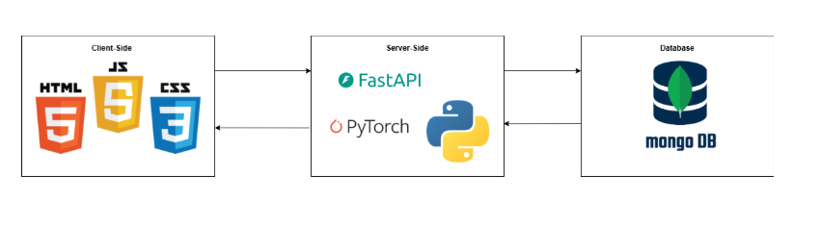
System Model

Slide 13
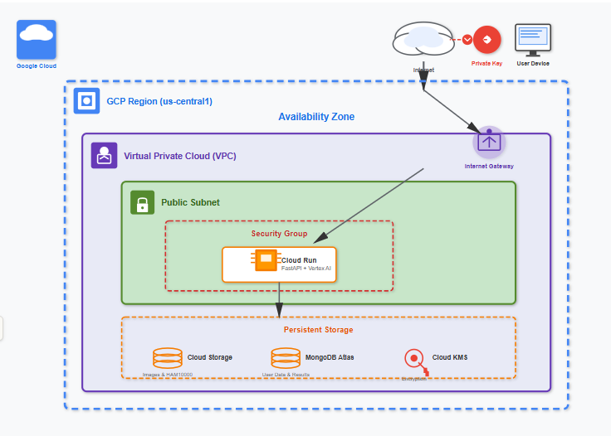
Google Cloud Services Model

Slide 14
Critical Tasks and Risks
Integration Rejection
Impact: Predictions might lack clarity or safety guidance, requiring late rework.
Action Plan: Early Grad-CAM, disclaimers, regular demos, clear user guidance
Technology Changes
Impact: PyTorch or GPU limits could delay accuracy goals or deployment.
Action Plan: Pin dependencies, lighter model ready, cloud GPU credits
Data Quality & Bias
Impact: Dataset imbalance may reduce accuracy across different skin tones.
Action Plan: Track subgroup metrics, data augmentation, confidence scores, warnings
Notes:
Manny

Slide 15
Critical Tasks and Risks
Unplanned Absences
Impact: Illness or emergencies could leave critical code unfinished.
Action Plan: Small tasks, pair programming, documentation
Scope Creep
Impact: Adding too many optional features may delay MVP or cause instability.
Action Plan: Use MoSCoW prioritization (Must, Should, Could, Won’t) and require team approval for any new feature.
Notes:
Manny

Slide 16
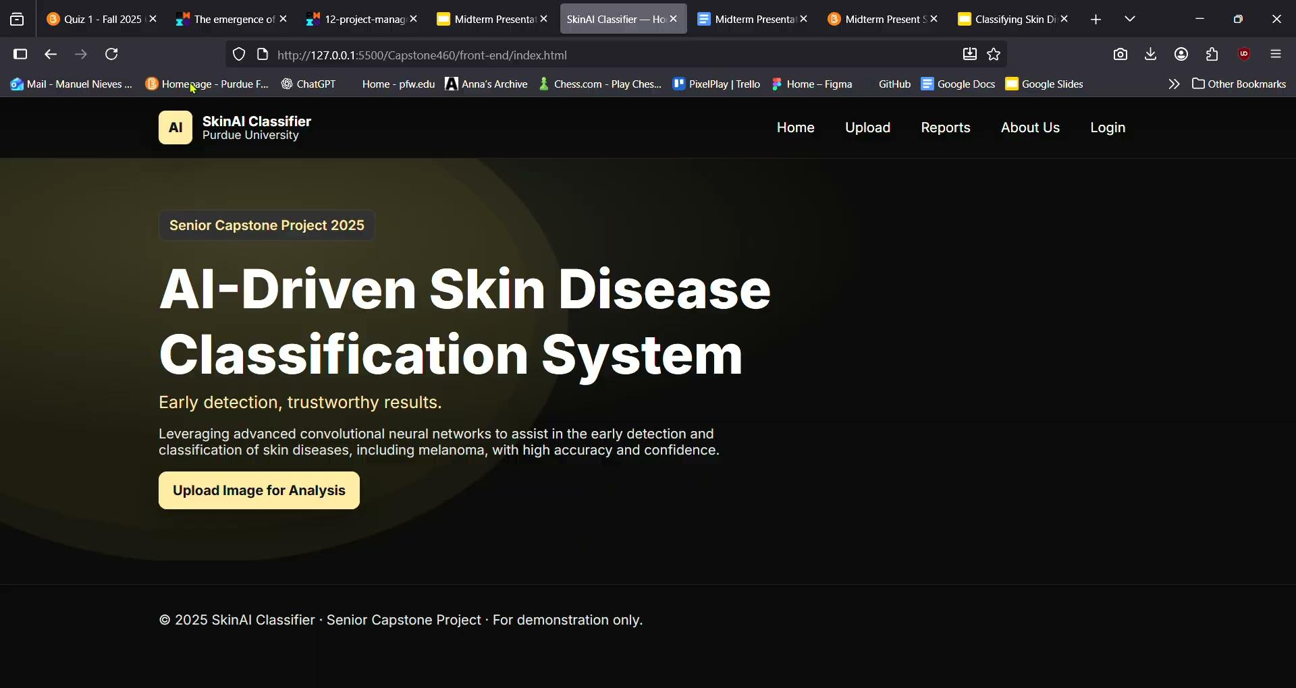
Video Demo
Notes:
Manny

Slide 17
Project Development Plan-Milestones
Sprint 1 – September
Set up Python env + GitHub repo
Collect HAM10000 dataset
Create Figma wireframes
Assign frontend/backend roles
Sprint 2 – October
Preprocess images
Begin CNN training (ResNet50)
Build basic frontend pages (Home,Upload, Reports, About, Login)
Sprint 3 – November
Implement account creation & user roles
Develop ChatBot
Integrate FastAPI backend
Connect frontend ↔ backend API
Enhancing Front-end
Sprint 4 – December
System integration demo
Deploy to Google Cloud test serve
Finalize risk assessment
Update report & presentation
Enhancing Front-end
Notes:
Manny

Slide 18
Thank you

